Slide 1
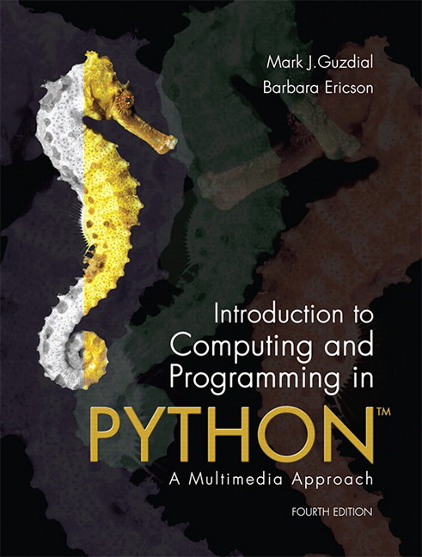
CSE 8A – Introduction to Programming and Computational Problem Solving I
CS1-LLMs Materials © 2023 by Leo Porter, Dan Zingaro, Beth Simon, and Christine Alvarado is licensed under CC BY-NC-SA 4.0
Image Processing Part 3
How to get help:
Class Website
https://sites.google.com/ucsd.edu/cse8afa23/home
Piazza for brief questions or logistic questions
Tutor Hours for help with homework/setting up computer To get help, use Autograder (directions on piazza)
Office Hours for homework/conceptual help
Slides based, in part, on materials from Dan Zingaro, Beth Simon, and Christine Alvarado.
Notes:
Welcome!

Slide 2
Announcements
Homework 7 due Monday at 10pm
Quiz 4
Code writing only
We’ll release a guide shortly.
Project 2 – Images
Lecture on next Tuesday (11/21) is remote
No Lab next week (or take-home lab)

Slide 3
Learning Goals for Today
By the end of today’s lecture, you should be able to:
Read and modify Python code that manipulates images using the Pillow (PIL) library
Including copying pixels within an image and changing pixels based on values or the values of nearby pixels

Slide 4
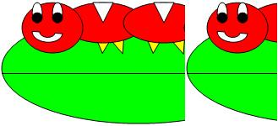
PART 1: Fill in the code below to copy the left ncols columns of the image to the right of the image. For example, the image below is where ncols is 1/3 the width
def copyNColumnsToRight(image, ncols):
width, height = image.size
sourceX = 0
targetX = __________________
while sourceX < _____________________ :
for y in range(height):
color = image.getpixel((sourceX,y))
image.putpixel((targetX,y),color)
sourceX = ___________
targetX = ___________
Notes:
Fill this in with them, no need to print this.
def copyNColumnsToRight(image, ncols):
width, height = image.size
sourceX = 0
targetX = width-1-ncols
while sourceX < ncols:
for y in range(height):
color = image.getpixel((sourceX,y))
image.putpixel((targetX,y),color)
sourceX = sourceX + 1
targetX = targetX + 1

Slide 5
PART 1: Fill in the code below to copy the left ncols columns of the image to the right of the image. For example, the image below is where ncols is 1/3 the width
When will the code below cause an out of bounds error?
def copyNColumnsToRight(image, ncols):
width, height = image.size
sourceX = 0
targetX = width-1-ncols
while sourceX < ncols:
for y in range(height):
color = image.getpixel((sourceX,y))
image.putpixel((targetX,y),color)
sourceX = sourceX + 1
targetX = targetX + 1
Notes:
Ugh, what if ncols is bigger than the image. We should probably fail silently here.
It’s really better to throw an exception when you get bad user input, but that’s beyond the scope of this course.

Slide 6
PART 1: Fill in the code below to copy the left ncols columns of the image to the right of the image. For example, the image below is where ncols is 1/3 the width
def copyNColumnsToRight(image, ncols):
width, height = image.size
sourceX = 0
targetX = width-1-ncols
while sourceX < ncols and targetX > 0:
for y in range(height):
color = image.getpixel((sourceX,y))
image.putpixel((targetX,y),color)
sourceX = sourceX + 1
targetX = targetX + 1
Notes:
If ncols is a really big number, we’re in trouble, so just adding targetX > 0 is fine to protect against that. (it could be >= 0 but then source will equal target which does nothing). I don’t think we need any additional conditions here

Slide 7
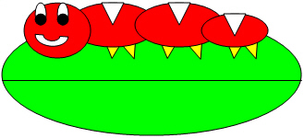
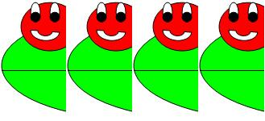
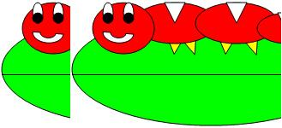
def copyNColumnsToRight(image, ncols):
width, height = image.size
sourceX = 0
targetX = width-1-ncols
while sourceX < ncols and targetX > 0 and sourceX < width:
for y in range(height):
color = image.getpixel((sourceX,y))
image.putpixel((targetX,y),color)
sourceX = sourceX + 1
targetX = targetX + 1
What will happen when ncols > half the width? For example, what happens when:
width,height = img.size
copyNColumnsToRight(img, 3*width//4)
A
B
Notes:
It’s A. You start copying over yourself. We could do get B if we used a different source image or if we copied right to left like this:
def copyNColumnsToRight(image, ncols):
width, height = image.size
sourceX = ncols-1
targetX = width-1
while sourceX >= 0 and targetX >= 0:
for y in range(height):
color = image.getpixel((sourceX,y))
image.putpixel((targetX,y),color)
sourceX = sourceX - 1
targetX = targetX - 1

Slide 8
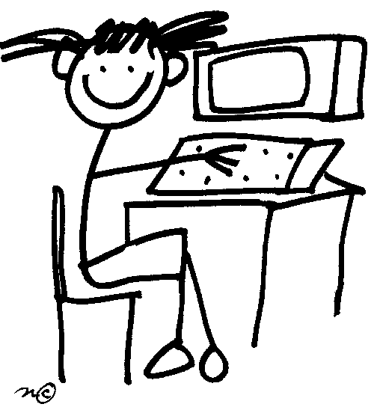
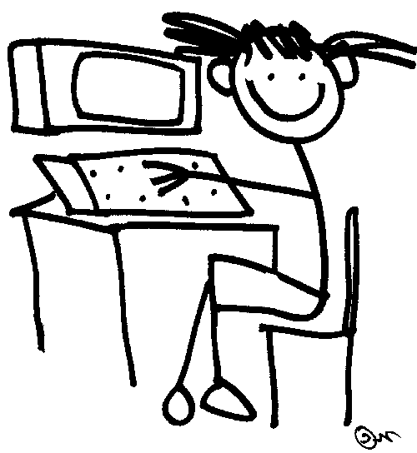
Mirroring Around Vertical Axis
Mirror left to right
Vertical axis

Slide 9
Mirroring Around Vertical Axis
Mirror right to left
Vertical axis

Slide 10
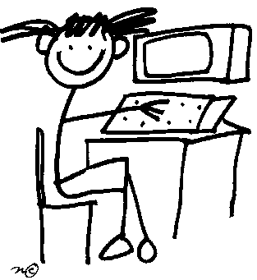
Mirroring Around Vertical Axis: Left to Right
What are the coordinates we use in the call to the Left Pixel (image.getpixel) and Right Pixel (result.putpixel) for the first three iterations of the inner loop? (assume picture has a width of 100 and height of 50)
Left Pixel
Right Pixel
def mirrorLeftToRight(image):
result = image.copy()
width, height = image.size
targetX = width-1
for sourceX in range(width//2):
for y in range(height):
color = image.getpixel((sourceX, y))
result.putpixel((targetX,y),color)
targetX = targetX - 1
return result
A) 0, 99 99, 0
0, 98 98, 0
0, 97 97, 0
B) 0, 0 99, 0
1, 0 98, 0
2, 0 97, 0
C) 0, 0 99, 0
0, 1 99, 1
0, 2 99, 2
B
D) 0, 0 49, 0
0, 1 49, 1
0, 2 49, 2
E) None of the other options
Notes:
Y values are changing, sourceX and targetX are not. So sourceX is going to be 0, 0, 0. targetX is going to be 99, 99, 99. Y is going 0, 1, 2
Show them you could also do this with a while loop:
def mirrorLeftToRight(image):
result = image.copy()
width, height = image.size
targetX = width-1
sourceX = 0
while sourceX < targetX:
for y in range(height):
color = image.getpixel((sourceX, y))
result.putpixel((targetX,y),color)
sourceX = sourceX + 1
targetX = targetX - 1
return result

Slide 11
Mirroring across the horizontal axis
source
To perform a mirroring of the top half onto the bottom half, will we need different y values in our source and target pixels?
Yes, because the y coordinate for the target pixel will be different than the y coordinate in the source pixel.
No, because the y coordinate in the target pixel will always be the same as the y coordinate in the source pixel.
target
Does it matter bottom into top
Or top into bottom? NO
What would assignment statements be?
B
Notes:
yes

Slide 12
Mirroring across the horizontal axis
source
def mirrorTopToBottom(image):
result = image.copy()
width, height = image.size
# code here
return result
target
Suppose sourceY is given the value of 0 at the start of execution. What is the corresponding value of targetY for an arbitrary image?
Same as the x value
height
height-1
width
width-1
This.getHeight()-1
Notes:
height -1

Slide 13
Mirroring across the horizontal axis
source
def mirrorTopToBottom(image):
result = image.copy()
width, height = image.size
# code here
for x in range(width):
targetY = height-1
for sourceY in range(height//2):
color = image.getpixel((x, sourceY))
result.putpixel((x,targetY),color)
return result
target
What is wrong with the code above?
Nothing
It does not update targety
The bound on sourcey in the inner for loop is not correct
The bound on x in the outer for loop is not correct
It is copying the colors backwards (i.e. it will mirror from bottom to top)
B
Notes:
B

Slide 14
Mirror versus “flip” (around vertical axis) Try on your own!!!
Mirror around vertical axis
Horizontal flip
original

Slide 15
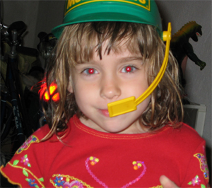
Red-eye reductions
What would happen if we replaced all the red Pixels? How can we avoid this issue?
Pixels change if meet both a COLOR and COORDINATE criteria

Slide 16

What parameters would YOU provide a user for a red eye reduction method?
Top left pixel coordinates for box to look for red eye in
Bottom right pixel coordinates for box to look for red eye in
Color to change red eyes to
Threshold value to determine if eyes are “red”
 | 1 | 2 | 3 | 4
A | X | X |  | X
B | X | X | X
C | X | X | X | X
D |  |  | X | X
E |  |  | X | X
Notes:
Answer, C. We need all of these.

Slide 17
Red-eye Reduction Parameters for good Software Engineering
def redEyeReduction(image, startX, startY, endX, endY, color):
result = image.copy()
width, height = result.size
for x in range(_________________________)):
for y in range(____________________________):
r, g, b = ____________________
if color_distance((r,g,b),______________________:
result.putpixel((x,y), color)
return result
Notes:
Add threshold as a parameter!
def redEyeReduction(image, startX, startY, endX, endY, color):
result = image.copy()
width, height = result.size
for x in range(max(0,startX), min(endX,width)):
for y in range(max(0, startY), min(height, endY)):
r, g, b = result.getpixel((x,y))
if color_distance((r,g,b),(255,0,0)) < 160:
result.putpixel((x,y), color)
return result

Slide 18
Summary
The Pillow (PIL) library offers useful functions for working with images
We can manipulate images in a variety of ways
Today we did more advanced operations like mirroring and using the value and region of pixels decide whether to change them or not.
Notes:
Next lecture. Copy one image onto another. Red-eye reduction. Edge Detection.

